Slide 1
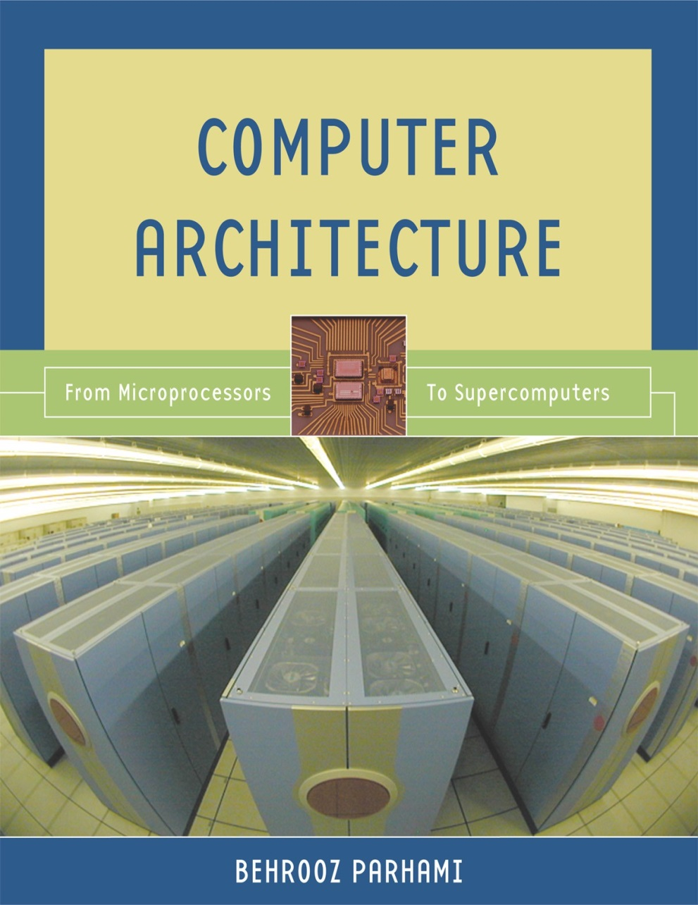
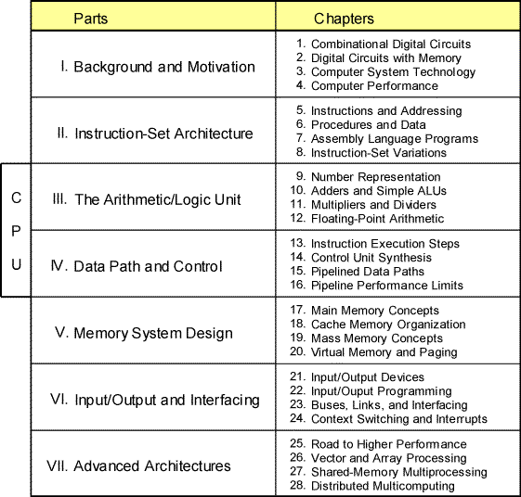
Part I
Background and Motivation
Oct. 2014
Computer Architecture, Background and Motivation
Slide <number>

Slide 2
About This Presentation
This presentation is intended to support the use of the textbook Computer Architecture: From Microprocessors to Supercomputers, Oxford University Press, 2005, ISBN 0-19-515455-X. It is updated regularly by the author as part of his teaching of the upper-division course ECE 154, Introduction to Computer Architecture, at the University of California, Santa Barbara. Instructors can use these slides freely in classroom teaching and for other educational purposes. Any other use is strictly prohibited. © Behrooz Parhami
Edition | Released | Revised | Revised | Revised | Revised
First | June 2003 | July 2004 | June 2005 | Mar. 2006 | Jan. 2007
 |  | Jan. 2008 | Jan. 2009 | Jan. 2011 | Oct. 2014
Second
Oct. 2014
Computer Architecture, Background and Motivation
Slide <number>

Slide 3
I Background and Motivation
Provide motivation, paint the big picture, introduce tools:
  Review components used in building digital circuits
  Present an overview of computer technology
  Understand the meaning of computer performance
  (or why a 2 GHz processor isn’t 2× as fast as a 1 GHz model)
Topics in This Part
Chapter 1 Combinational Digital Circuits
Chapter 2 Digital Circuits with Memory
Chapter 3 Computer System Technology
Chapter 4 Computer Performance
Oct. 2014
Computer Architecture, Background and Motivation
Slide <number>

Slide 4
1 Combinational Digital Circuits
First of two chapters containing a review of digital design:
  Combinational, or memoryless, circuits in Chapter 1
  Sequential circuits, with memory, in Chapter 2
Topics in This Chapter
1.1 Signals, Logic Operators, and Gates
1.2 Boolean Functions and Expressions
1.3 Designing Gate Networks
1.4 Useful Combinational Parts
1.5 Programmable Combinational Parts
1.6 Timing and Circuit Considerations
Oct. 2014
Computer Architecture, Background and Motivation
Slide <number>

Slide 5
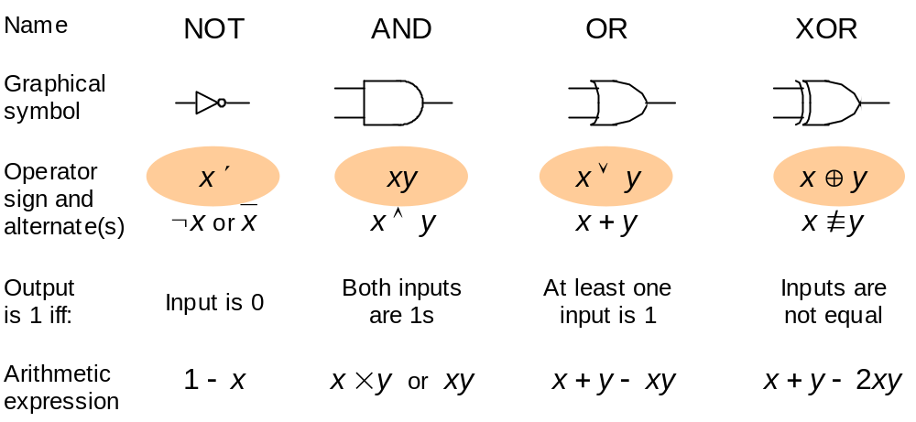
1.1 Signals, Logic Operators, and Gates
Add: 1 + 1 = 10
Figure 1.1 Some basic elements of digital logic circuits, with operator signs used in this book highlighted.
Oct. 2014
Computer Architecture, Background and Motivation
Slide <number>

Slide 6
The Arithmetic Substitution Method
z ′ = 1 – z NOT converted to arithmetic form
xy AND same as multiplication
(when doing the algebra, set z^{k} = z)
x ∨ y = x + y − xy OR converted to arithmetic form
x ⊕ y = x + y − 2xy XOR converted to arithmetic form
Example: Prove the identity xyz ∨ x ′ ∨ y ′ ∨ z ′ ≡? 1
LHS = [xyz ∨ x ′] ∨ [y ′ ∨ z ′]
= [xyz + 1 – x – (1 – x)xyz] ∨ [1 – y + 1 – z – (1 – y)(1 – z)]
= [xyz + 1 – x] ∨ [1 – yz]
= (xyz + 1 – x) + (1 – yz) – (xyz + 1 – x)(1 – yz)
= 1 + xy²z² – xyz
= 1 = RHS
This is addition, not logical OR
Oct. 2014
Computer Architecture, Background and Motivation
Slide <number>

Slide 7
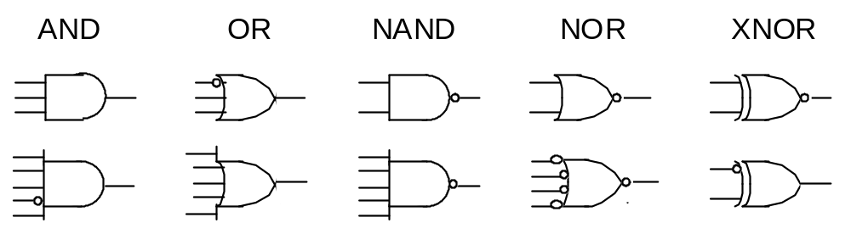
Variations in Gate Symbols
Bubble = Inverter
Figure 1.2 Gates with more than two inputs and/or with inverted signals at input or output.
Oct. 2014
Computer Architecture, Background and Motivation
Slide <number>

Slide 8
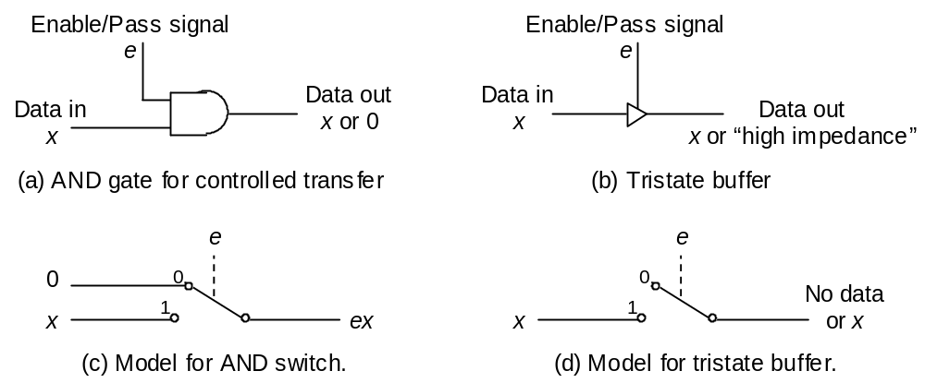
Gates as Control Elements
Figure 1.3 An AND gate and a tristate buffer act as controlled switches or valves. An inverting buffer is logically the same as a NOT gate.
Oct. 2014
Computer Architecture, Background and Motivation
Slide <number>

Slide 9
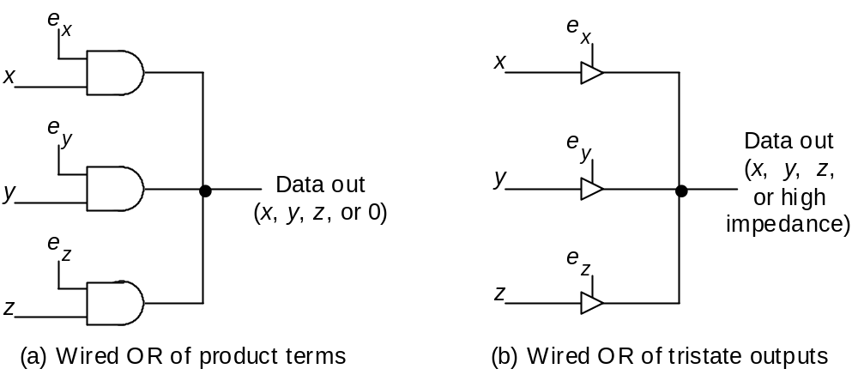
Wired OR and Bus Connections
Figure 1.4 Wired OR allows tying together of several controlled signals.
Oct. 2014
Computer Architecture, Background and Motivation
Slide <number>

Slide 10
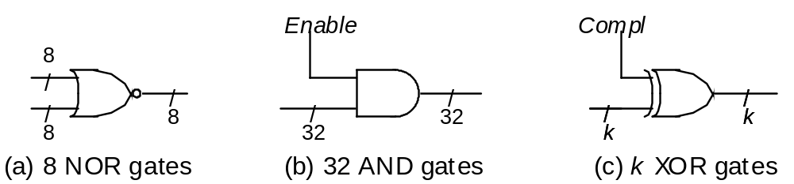
Control/Data Signals and Signal Bundles
Figure 1.5 Arrays of logic gates represented by a single gate symbol.
Oct. 2014
Computer Architecture, Background and Motivation
Slide <number>

Slide 11
1.2 Boolean Functions and Expressions
Ways of specifying a logic function
• Truth table: 2^{n} row, “don’t-care” in input or output
• Logic expression: w ′ (x ∨ y ∨ z), product-of-sums,
sum-of-products, equivalent expressions
• Word statement: Alarm will sound if the door
is opened while the security system is engaged,
or when the smoke detector is triggered
• Logic circuit diagram: Synthesis vs analysis
Oct. 2014
Computer Architecture, Background and Motivation
Slide <number>

Slide 12
Manipulating Logic Expressions
Table 1.2 Laws (basic identities) of Boolean algebra.
Name of law | OR version | AND version
Identity | x ∨ 0 = x | x 1 = x
One/Zero | x ∨ 1 = 1 | x 0 = 0
Idempotent | x ∨ x = x | x x = x
Inverse | x ∨ x ′ = 1 | x x ′ = 0
Commutative | x ∨ y = y ∨ x | x y = y x
Associative | (x ∨ y) ∨ z = x ∨ (y ∨ z) | (x y) z = x (y z)
Distributive | x ∨ (y z) = (x ∨ y) (x ∨ z) | x (y ∨ z) = (x y) ∨ (x z)
DeMorgan’s | (x ∨ y)′ = x ′ y ′ | (x y)′ = x ′ ∨ y ′
Oct. 2014
Computer Architecture, Background and Motivation
Slide <number>

Slide 13
Proving the Equivalence of Logic Expressions
Example 1.1
• Truth-table method: Exhaustive verification
• Arithmetic substitution
x ∨ y = x + y − xy
x ⊕ y = x + y − 2xy
• Case analysis: two cases, x = 0 or x = 1
• Logic expression manipulation
Example: x ⊕ y ≡? x ′y ∨ x y ′
x + y – 2xy ≡? (1 – x)y + x(1 – y) – (1 – x)yx(1 – y)
Oct. 2014
Computer Architecture, Background and Motivation
Slide <number>

Slide 14
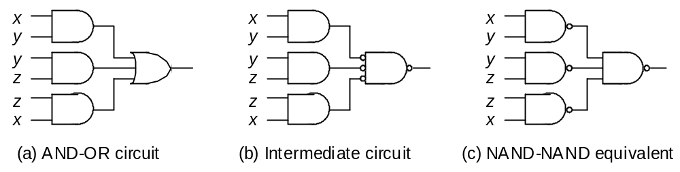
1.3 Designing Gate Networks
• AND-OR, NAND-NAND, OR-AND, NOR-NOR
• Logic optimization: cost, speed, power dissipation
(a ∨ b ∨ c)′ = a ′b ′c ′
Figure 1.6 A two-level AND-OR circuit and two equivalent circuits.
Oct. 2014
Computer Architecture, Background and Motivation
Slide <number>

Slide 15
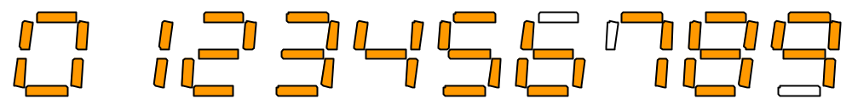
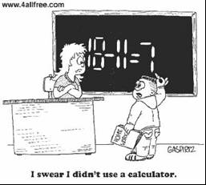
Seven-Segment Display of Decimal Digits
Optional segment
Figure 1.7 Seven-segment display of decimal digits. The three open segments may be optionally used. The digit 1 can be displayed in two ways, with the more common right-side version shown.
I swear I didn’t use a calculator!
Oct. 2014
Computer Architecture, Background and Motivation
Slide <number>

Slide 16
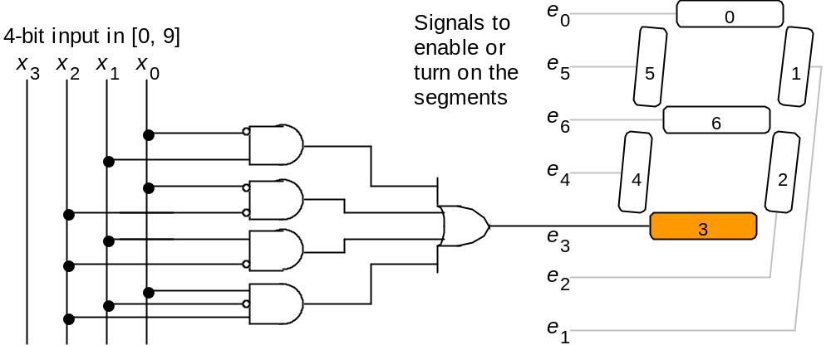
BCD-to-Seven-Segment Decoder
Example 1.2
Figure 1.8 The logic circuit that generates the enable signal for the lowermost segment (number 3) in a seven-segment display unit.
Oct. 2014
Computer Architecture, Background and Motivation
Slide <number>

Slide 17
1.4 Useful Combinational Parts
• High-level building blocks
• Much like prefab parts used in building a house
• Arithmetic components (adders, multipliers, ALUs)
will be covered in Part III
• Here we cover three useful parts:
multiplexers, decoders/demultiplexers, encoders
Oct. 2014
Computer Architecture, Background and Motivation
Slide <number>

Slide 18
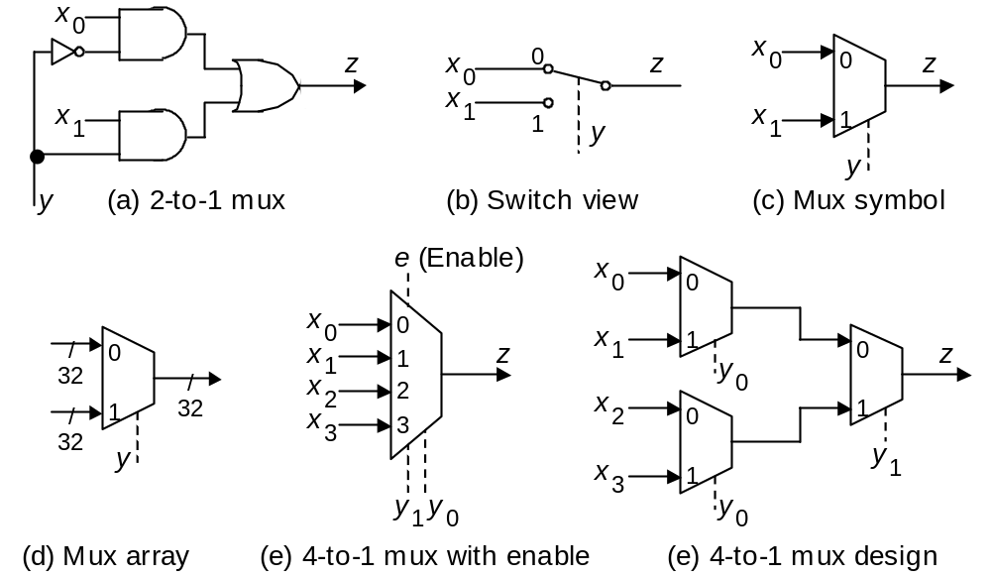
Multiplexers
x₂
1 0
Figure 1.9 Multiplexer (mux), or selector, allows one of several inputs to be selected and routed to output depending on the binary value of a set of selection or address signals provided to it.
Oct. 2014
Computer Architecture, Background and Motivation
Slide <number>

Slide 19
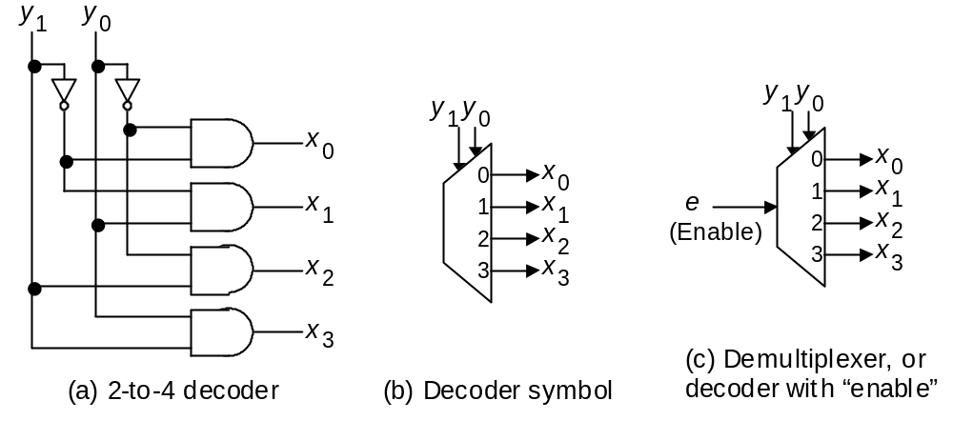
Decoders/Demultiplexers
1 0
1 0
1
1
1
1
1
Figure 1.10 A decoder allows the selection of one of 2ª options using an a-bit address as input. A demultiplexer (demux) is a decoder that only selects an output if its enable signal is asserted.
Oct. 2014
Computer Architecture, Background and Motivation
Slide <number>

Slide 20
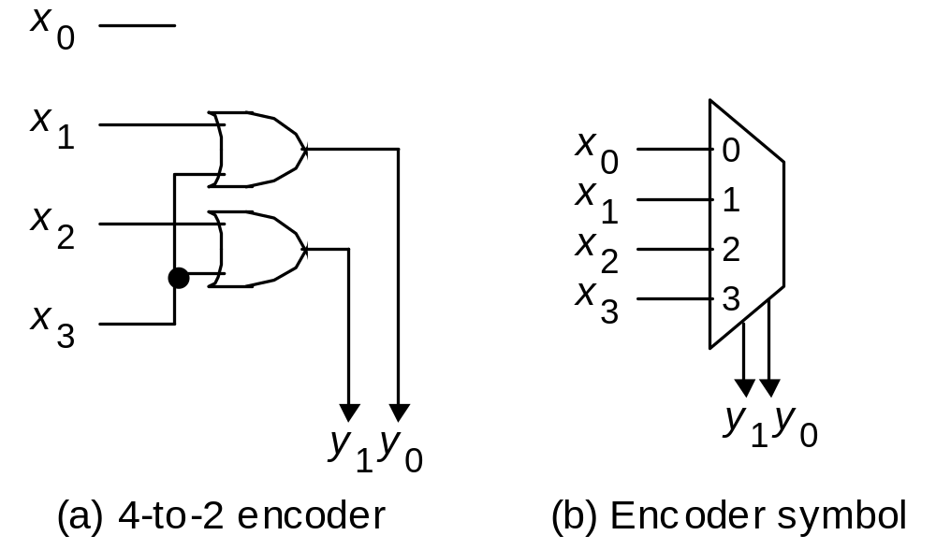
Encoders
0
0
1
0
1 0
Figure 1.11 A 2ª-to-a encoder outputs an a-bit binary number equal to the index of the single 1 among its 2ª inputs.
Oct. 2014
Computer Architecture, Background and Motivation
Slide <number>

Slide 21
1.5 Programmable Combinational Parts
A programmable combinational part can do the job of many gates or gate networks
Programmed by cutting existing connections (fuses) or establishing new connections (antifuses)
• Programmable ROM (PROM)
• Programmable array logic (PAL)
• Programmable logic array (PLA)
Oct. 2014
Computer Architecture, Background and Motivation
Slide <number>

Slide 22
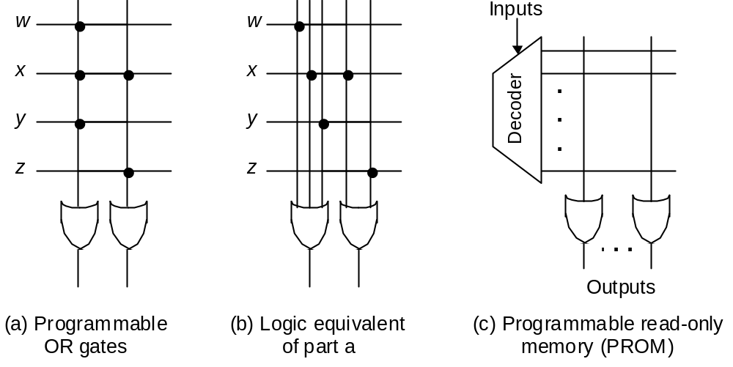
PROMs
Figure 1.12 Programmable connections and their use in a PROM.
Oct. 2014
Computer Architecture, Background and Motivation
Slide <number>

Slide 23
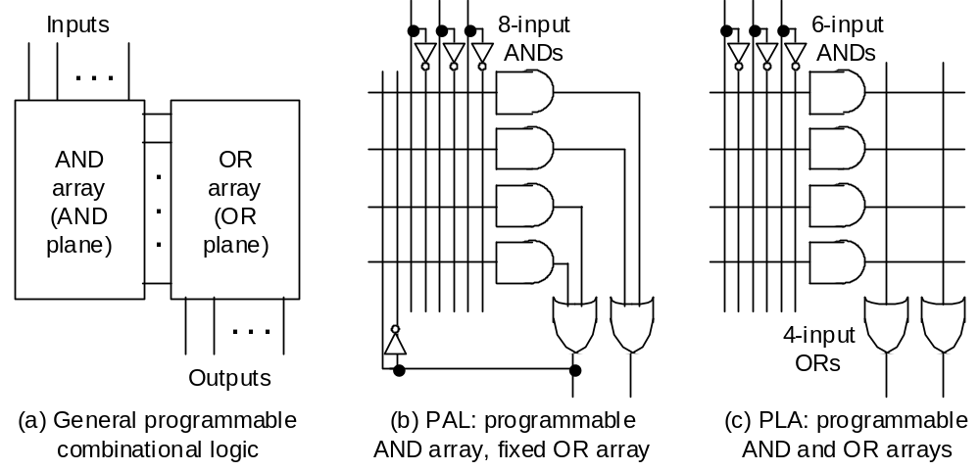
PALs and PLAs
Figure 1.13 Programmable combinational logic: general structure and two classes known as PAL and PLA devices. Not shown is PROM with fixed AND array (a decoder) and programmable OR array.
Oct. 2014
Computer Architecture, Background and Motivation
Slide <number>

Slide 24
1.6 Timing and Circuit Considerations
Changes in gate/circuit output, triggered by changes in its inputs, are not instantaneous
• Gate delay δ: a fraction of, to a few, nanoseconds
• Wire delay, previously negligible, is now important
(electronic signals travel about 15 cm per ns)
• Circuit simulation to verify function and timing
Oct. 2014
Computer Architecture, Background and Motivation
Slide <number>

Slide 25
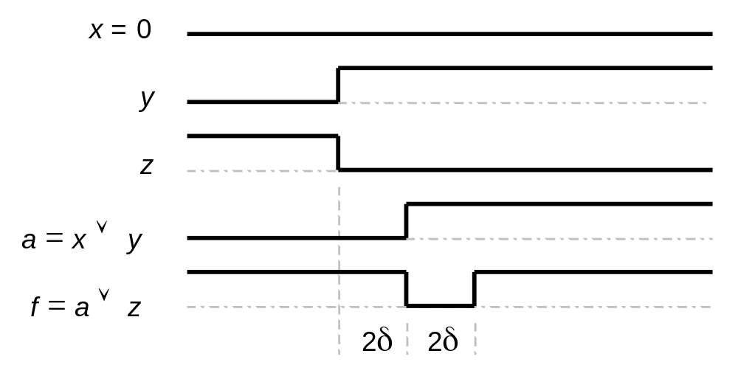
Glitching
Using the PAL in Fig. 1.13b to implement f = x ∨ y ∨ z
x
AND-OR
(PAL)
a
y
AND-OR
(PAL)
f
z
Figure 1.14 Timing diagram for a circuit that exhibits glitching.
Oct. 2014
Computer Architecture, Background and Motivation
Slide <number>

Slide 26
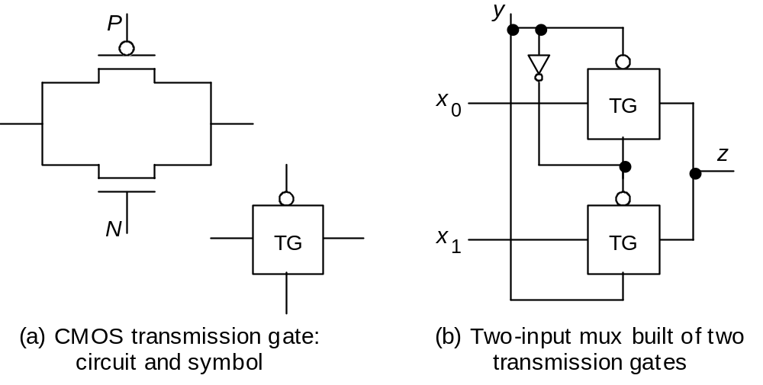
CMOS Transmission Gates
Figure 1.15 A CMOS transmission gate and its use in building a 2-to-1 mux.
Oct. 2014
Computer Architecture, Background and Motivation
Slide <number>

Slide 27
2 Digital Circuits with Memory
Second of two chapters containing a review of digital design:
  Combinational (memoryless) circuits in Chapter 1
  Sequential circuits (with memory) in Chapter 2
Topics in This Chapter
2.1 Latches, Flip-Flops, and Registers
2.2 Finite-State Machines
2.3 Designing Sequential Circuits
2.4 Useful Sequential Parts
2.5 Programmable Sequential Parts
2.6 Clocks and Timing of Events
Oct. 2014
Computer Architecture, Background and Motivation
Slide <number>

Slide 28
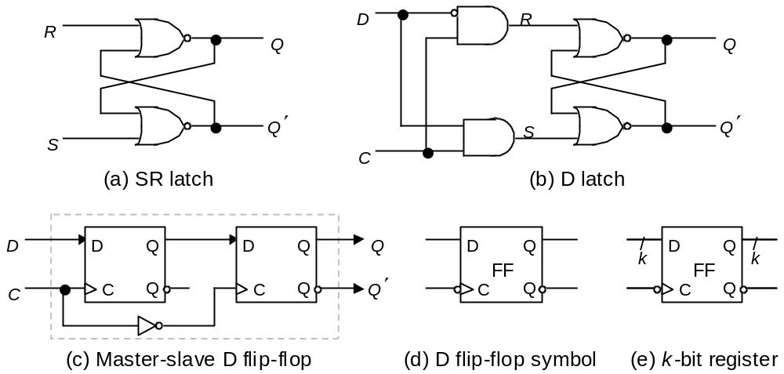
2.1 Latches, Flip-Flops, and Registers
Figure 2.1 Latches, flip-flops, and registers.
Oct. 2014
Computer Architecture, Background and Motivation
Slide <number>

Slide 29
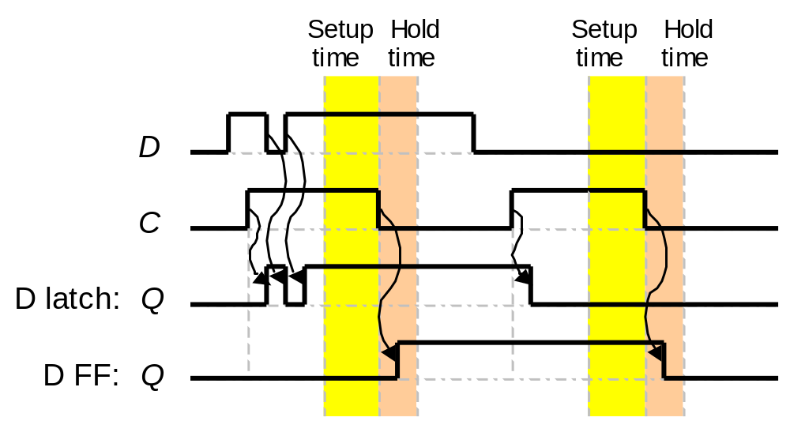
Latches vs Flip-Flops
D
Q
C
Q
D
Q
FF
C
Q
Figure 2.2 Operations of D latch and negative-edge-triggered D flip-flop.
Oct. 2014
Computer Architecture, Background and Motivation
Slide <number>

Slide 30
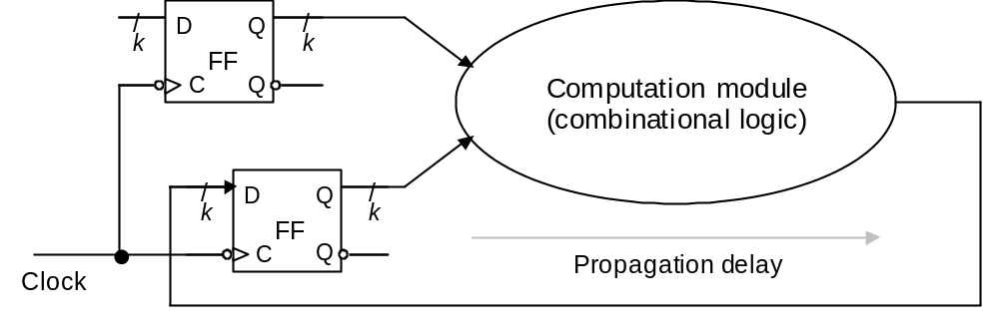
Reading and Modifying FFs in the Same Cycle
Combinational delay
Figure 2.3 Register-to-register operation with edge-triggered flip-flops.
Oct. 2014
Computer Architecture, Background and Motivation
Slide <number>

Slide 31
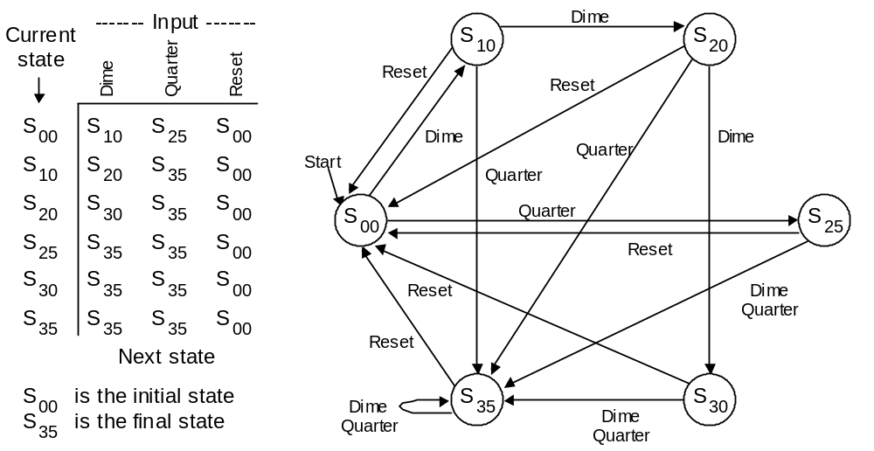
2.2 Finite-State Machines
Example 2.1
Figure 2.4 State table and state diagram for a vending machine coin reception unit.
Oct. 2014
Computer Architecture, Background and Motivation
Slide <number>

Slide 32
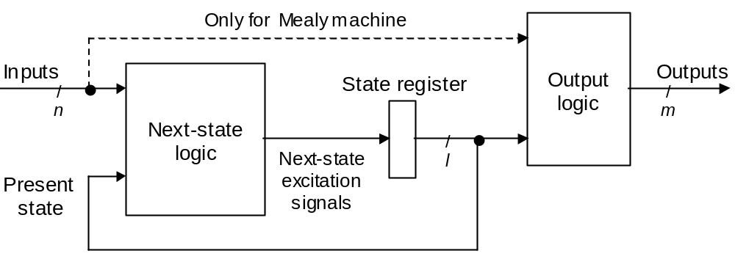
Sequential Machine Implementation
Figure 2.5 Hardware realization of Moore and Mealy sequential machines.
Oct. 2014
Computer Architecture, Background and Motivation
Slide <number>

Slide 33
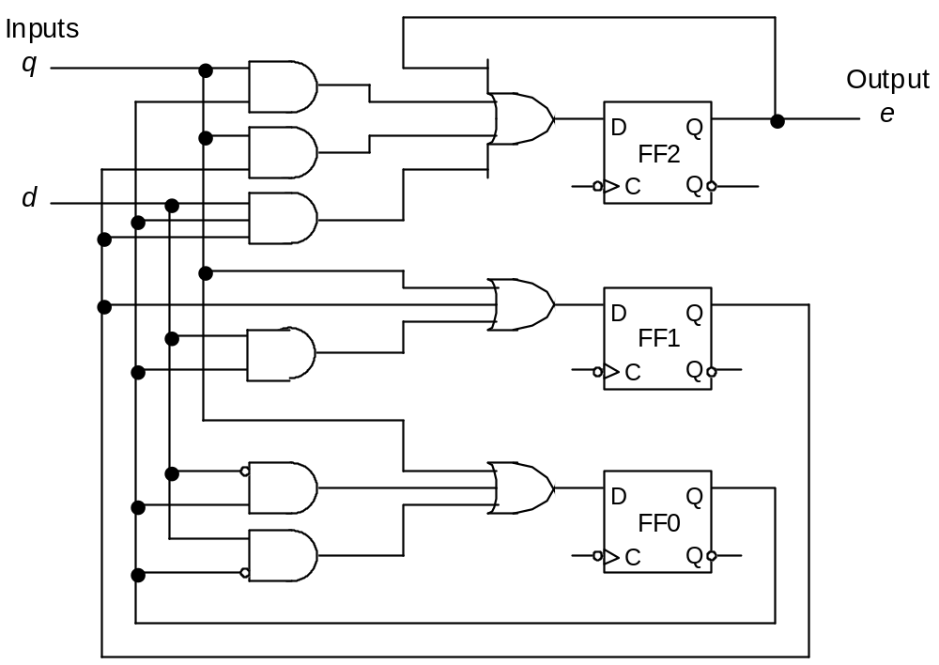
2.3 Designing Sequential Circuits
Example 2.3
Quarter in
Final state is 1xx
Dime in
Figure 2.7 Hardware realization of a coin reception unit (Example 2.3).
Oct. 2014
Computer Architecture, Background and Motivation
Slide <number>

Slide 34
2.4 Useful Sequential Parts
• High-level building blocks
• Much like prefab closets used in building a house
• Other memory components will be covered in
Chapter 17 (SRAM details, DRAM, Flash)
• Here we cover three useful parts:
shift register, register file (SRAM basics), counter
Oct. 2014
Computer Architecture, Background and Motivation
Slide <number>

Slide 35
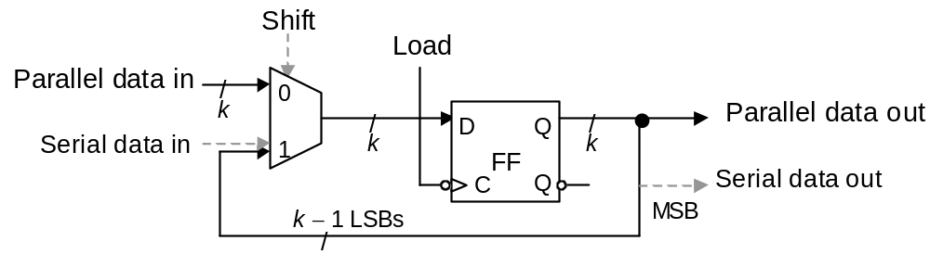
Shift Register
0 1 0 0 1 1 1 0
Figure 2.8 Register with single-bit left shift and parallel load capabilities. For logical left shift, serial data in line is connected to 0.
Oct. 2014
Computer Architecture, Background and Motivation
Slide <number>

Slide 36
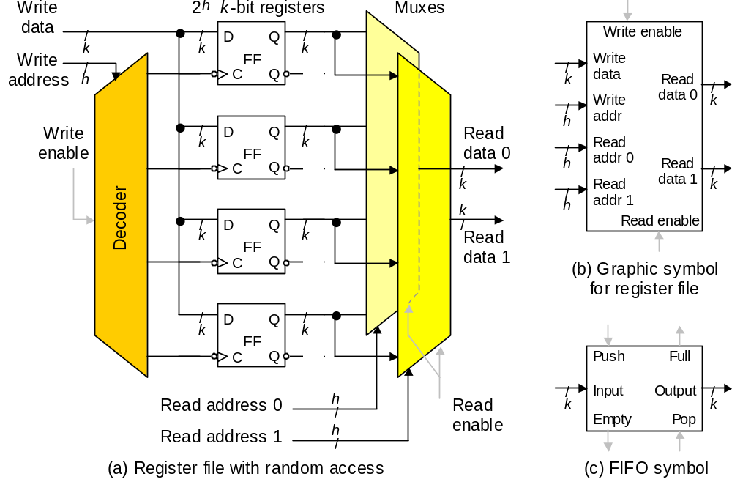
Register File and FIFO
Figure 2.9 Register file with random access and FIFO.
Oct. 2014
Computer Architecture, Background and Motivation
Slide <number>

Slide 37
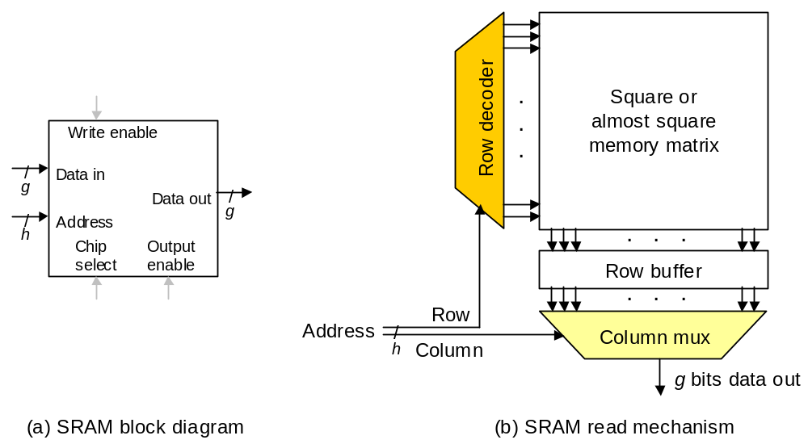
SRAM
Figure 2.10 SRAM memory is simply a large, single-port register file.
Oct. 2014
Computer Architecture, Background and Motivation
Slide <number>

Slide 38
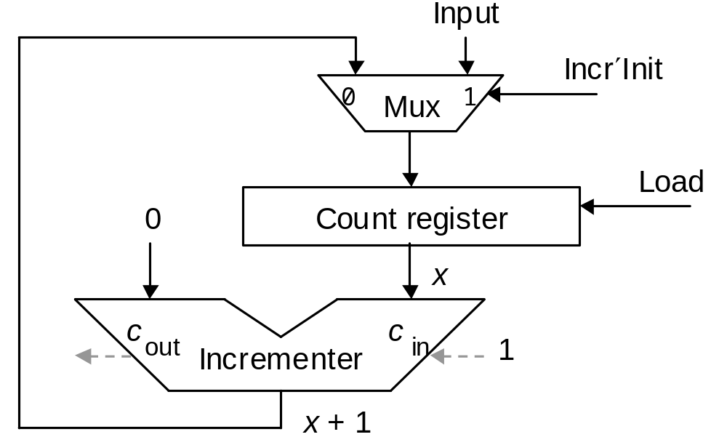
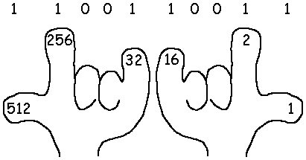
Binary Counter
Figure 2.11 Synchronous binary counter with initialization capability.
Oct. 2014
Computer Architecture, Background and Motivation
Slide <number>

Slide 39
2.5 Programmable Sequential Parts
A programmable sequential part contain gates and memory elements
Programmed by cutting existing connections (fuses) or establishing new connections (antifuses)
• Programmable array logic (PAL)
• Field-programmable gate array (FPGA)
• Both types contain macrocells and interconnects
Oct. 2014
Computer Architecture, Background and Motivation
Slide <number>

Slide 40
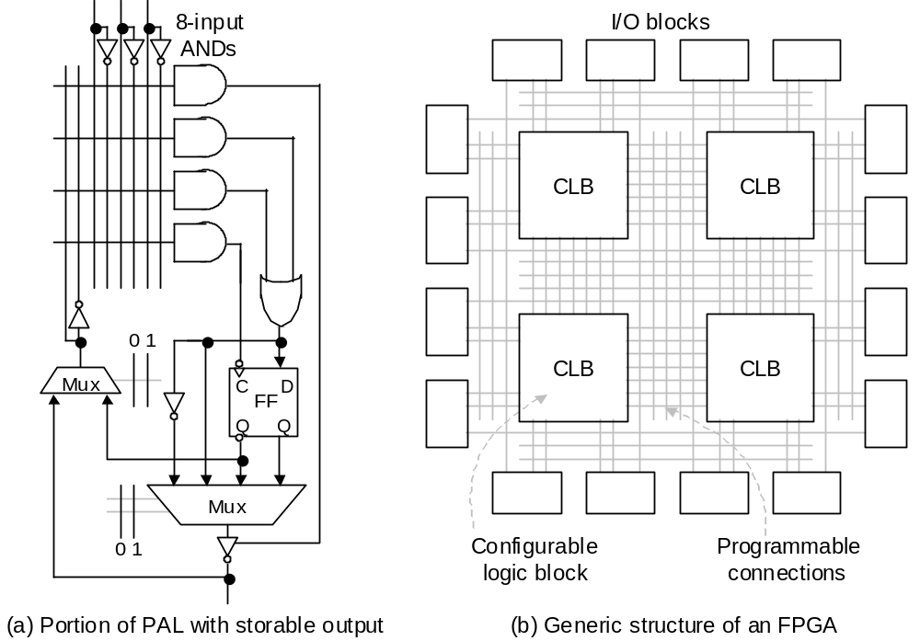
PAL and FPGA
Figure 2.12 Examples of programmable sequential logic.
Oct. 2014
Computer Architecture, Background and Motivation
Slide <number>

Slide 41
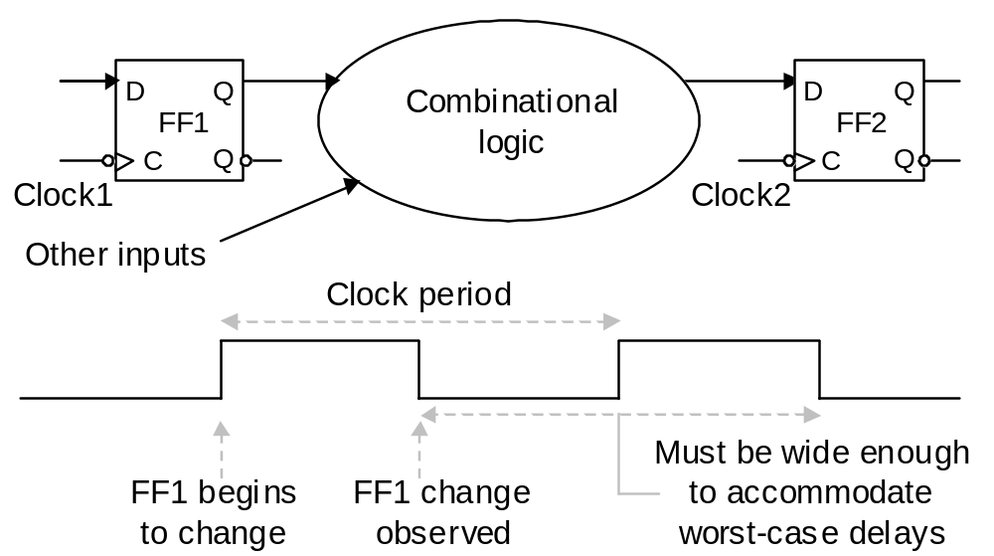
2.6 Clocks and Timing of Events
Clock is a periodic signal: clock rate = clock frequency
The inverse of clock rate is the clock period: 1 GHz ↔ 1 ns
Constraint: Clock period ≥ t_{prop} + t_{comb} + t_{setup} + t_{skew}
Figure 2.13 Determining the required length of the clock period.
Oct. 2014
Computer Architecture, Background and Motivation
Slide <number>

Slide 42
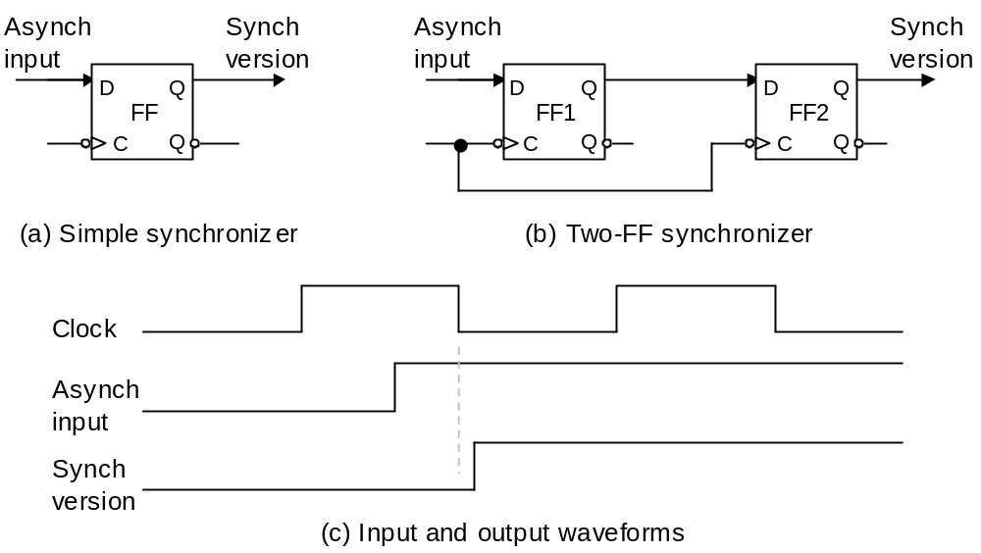
Synchronization
Figure 2.14 Synchronizers are used to prevent timing problems arising from untimely changes in asynchronous signals.
Oct. 2014
Computer Architecture, Background and Motivation
Slide <number>

Slide 43
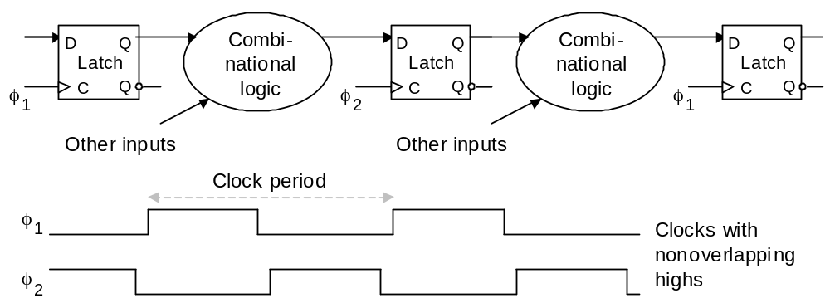
Level-Sensitive Operation
Figure 2.15 Two-phase clocking with nonoverlapping clock signals.
Oct. 2014
Computer Architecture, Background and Motivation
Slide <number>

Slide 44
3 Computer System Technology
Interplay between architecture, hardware, and software
  Architectural innovations influence technology
  Technological advances drive changes in architecture
Topics in This Chapter
3.1 From Components to Applications
3.2 Computer Systems and Their Parts
3.3 Generations of Progress
3.4 Processor and Memory Technologies
3.5 Peripherals, I/O, and Communications
3.6 Software Systems and Applications
Oct. 2014
Computer Architecture, Background and Motivation
Slide <number>

Slide 45
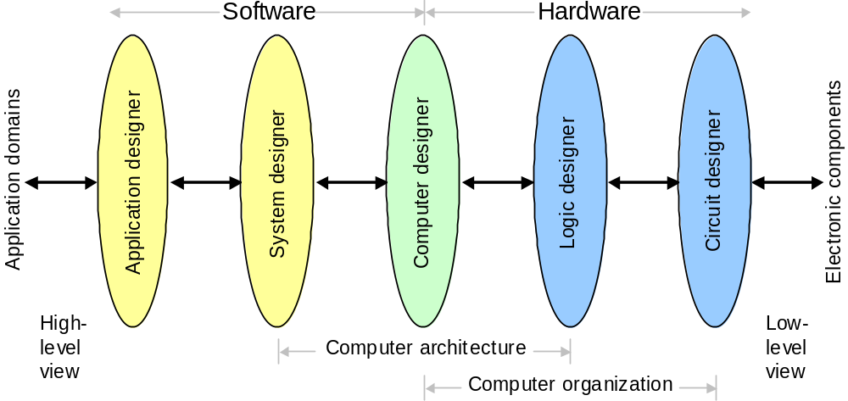
3.1 From Components to Applications
Figure 3.1 Subfields or views in computer system engineering.
Oct. 2014
Computer Architecture, Background and Motivation
Slide <number>

Slide 46
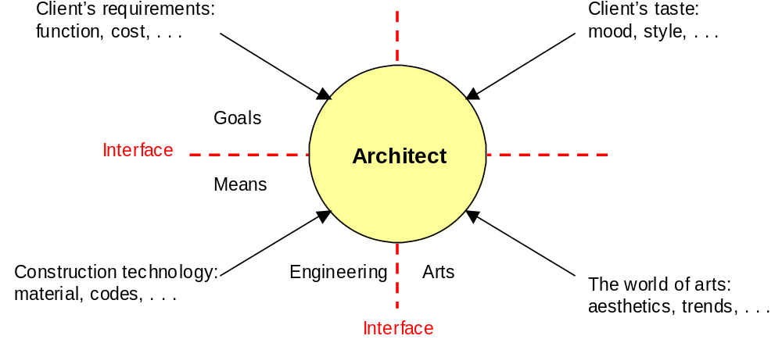
What Is (Computer) Architecture?
Figure 3.2 Like a building architect, whose place at the engineering/arts and goals/means interfaces is seen in this diagram, a computer architect reconciles many conflicting or competing demands.
Oct. 2014
Computer Architecture, Background and Motivation
Slide <number>

Slide 47
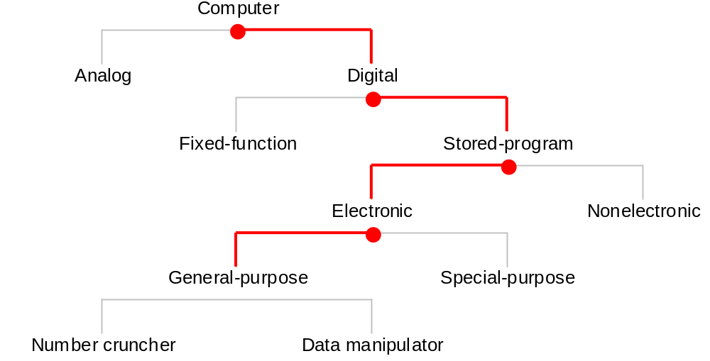
3.2 Computer Systems and Their Parts
Figure 3.3 The space of computer systems, with what we normally mean by the word “computer” highlighted.
Oct. 2014
Computer Architecture, Background and Motivation
Slide <number>

Slide 48
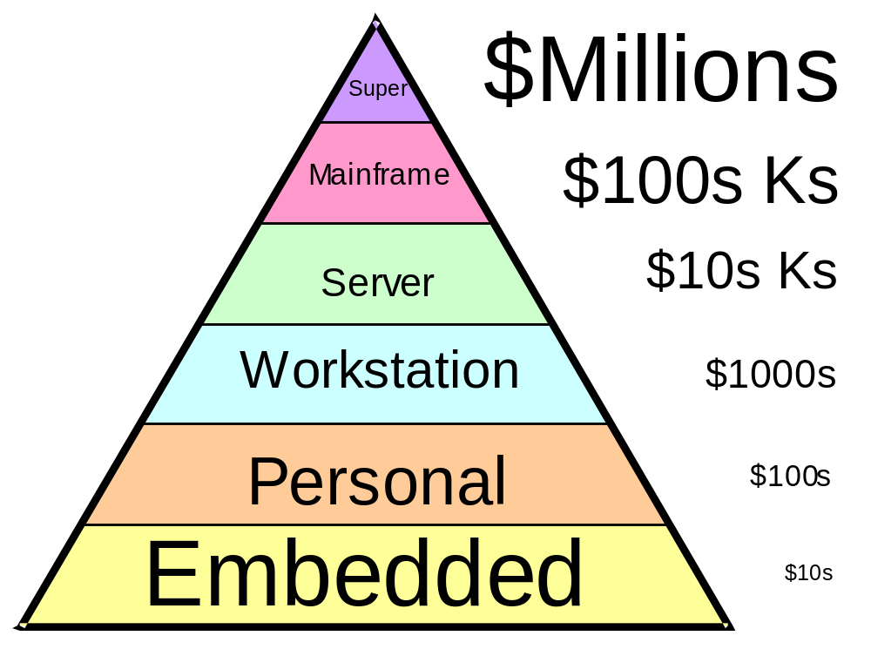
Price/Performance Pyramid
Differences in scale,
not in substance
Figure 3.4 Classifying computers by computational power and price range.
Oct. 2014
Computer Architecture, Background and Motivation
Slide <number>

Slide 49
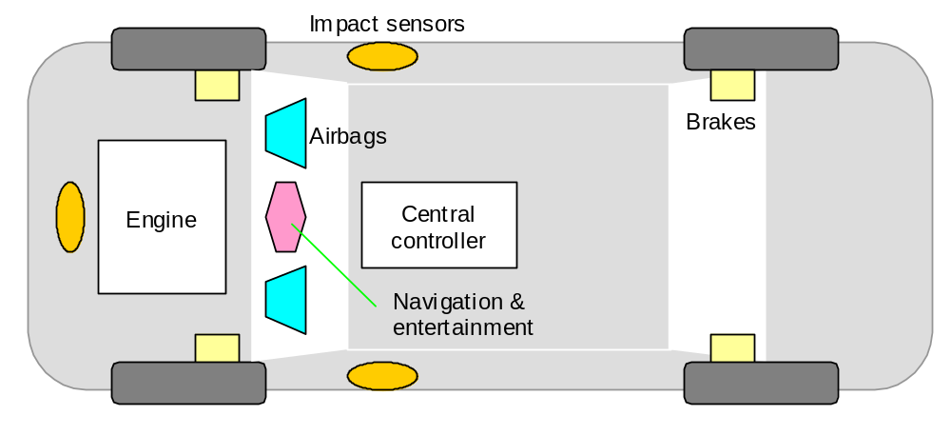
Automotive Embedded Computers
Figure 3.5 Embedded computers are ubiquitous, yet invisible. They are found in our automobiles, appliances, and many other places.
Oct. 2014
Computer Architecture, Background and Motivation
Slide <number>

Slide 50
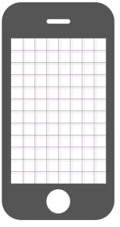

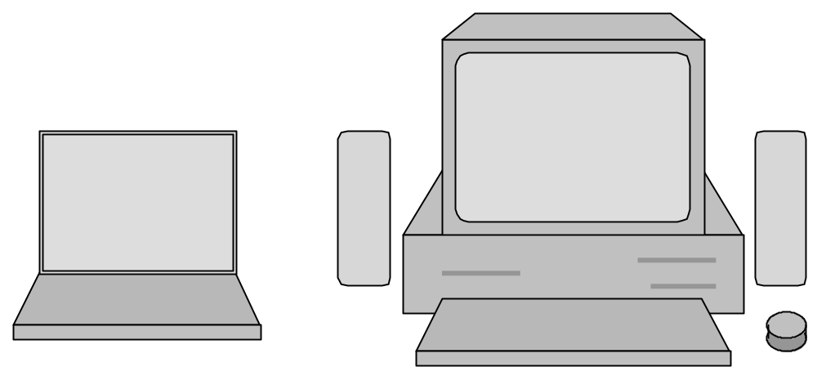
Personal Computers and Workstations
Figure 3.6 Notebooks, a common class of portable computers, are much smaller than desktops but offer substantially the same capabilities. What are the main reasons for the size difference?
Oct. 2014
Computer Architecture, Background and Motivation
Slide <number>

Slide 51
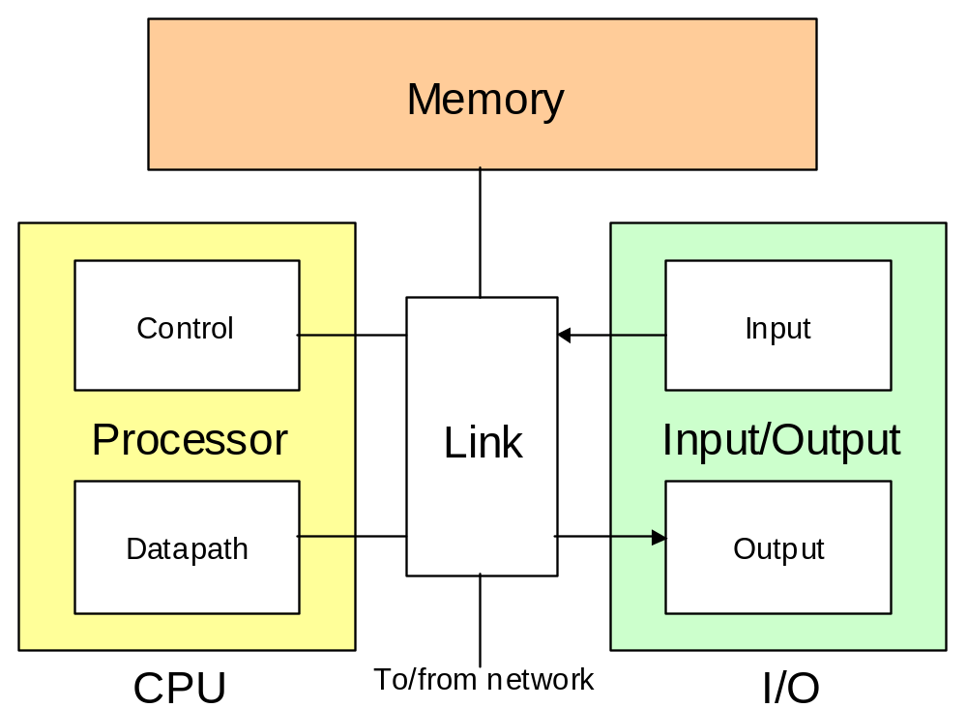
Digital Computer Subsystems
Figure 3.7 The (three, four, five, or) six main units of a digital computer. Usually, the link unit (a simple bus or a more elaborate network) is not explicitly included in such diagrams.
Oct. 2014
Computer Architecture, Background and Motivation
Slide <number>

Slide 52
3.3 Generations of Progress
Table 3.2 The 5 generations of digital computers, and their ancestors.
Generation (begun) | Processor technology | Memory innovations | I/O devices introduced | Dominant look & fell
0 (1600s) | (Electro-) mechanical | Wheel, card | Lever, dial, punched card | Factory equipment
1 (1950s) | Vacuum tube | Magnetic drum | Paper tape, magnetic tape | Hall-size cabinet
2 (1960s) | Transistor | Magnetic core | Drum, printer, text terminal | Room-size mainframe
3 (1970s) | SSI/MSI | RAM/ROM chip | Disk, keyboard, video monitor | Desk-size mini
4 (1980s) | LSI/VLSI | SRAM/DRAM | Network, CD, mouse,sound | Desktop/ laptop micro
5 (1990s) | ULSI/GSI/ WSI, SOC | SDRAM, flash | Sensor/actuator, point/click | Invisible, embedded
Oct. 2014
Computer Architecture, Background and Motivation
Slide <number>

Slide 53
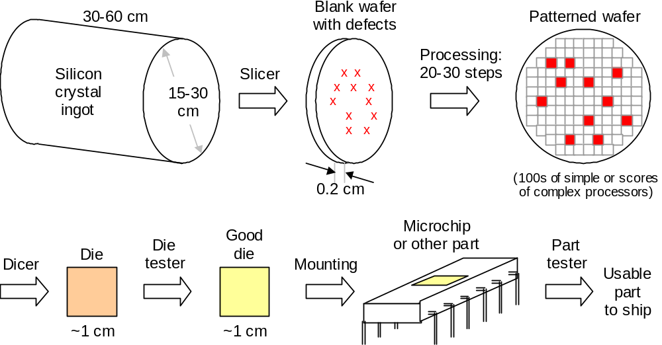
IC Production and Yield
Figure 3.8 The manufacturing process for an IC part.
Oct. 2014
Computer Architecture, Background and Motivation
Slide <number>

Slide 54
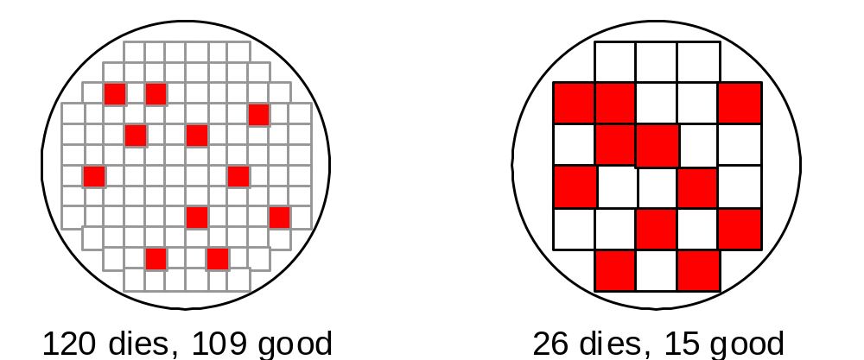
Effect of Die Size on Yield
Figure 3.9 Visualizing the dramatic decrease in yield with larger dies.
Die yield =_{def} (number of good dies) / (total number of dies)
Die yield = Wafer yield × [1 + (Defect density × Die area) / a]^{–a}
Die cost = (cost of wafer) / (total number of dies × die yield)
= (cost of wafer) × (die area / wafer area) / (die yield)
Oct. 2014
Computer Architecture, Background and Motivation
Slide <number>

Slide 55
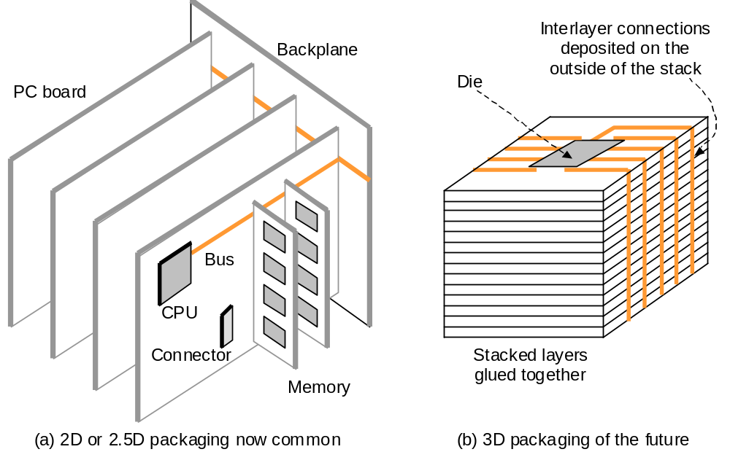
3.4 Processor and Memory Technologies
Figure 3.11 Packaging of processor, memory, and other components.
Oct. 2014
Computer Architecture, Background and Motivation
Slide <number>

Slide 56
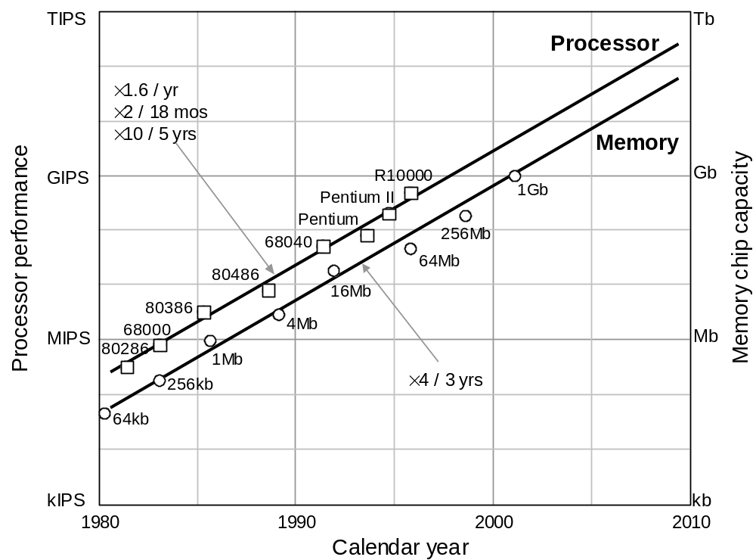
Moore’s Law
Figure 3.10 Trends in processor performance and DRAM memory chip capacity (Moore’s law).
Oct. 2014
Computer Architecture, Background and Motivation
Slide <number>

Slide 57
Pitfalls of Computer Technology Forecasting
“DOS addresses only 1 MB of RAM because we cannot imagine any applications needing more.” Microsoft, 1980
“640K ought to be enough for anybody.” Bill Gates, 1981
“Computers in the future may weigh no more than 1.5 tons.” Popular Mechanics
“I think there is a world market for maybe five computers.” Thomas Watson, IBM Chairman, 1943
“There is no reason anyone would want a computer in their home.” Ken Olsen, DEC founder, 1977
“The 32-bit machine would be an overkill for a personal computer.” Sol Libes, ByteLines
Oct. 2014
Computer Architecture, Background and Motivation
Slide <number>

Slide 58

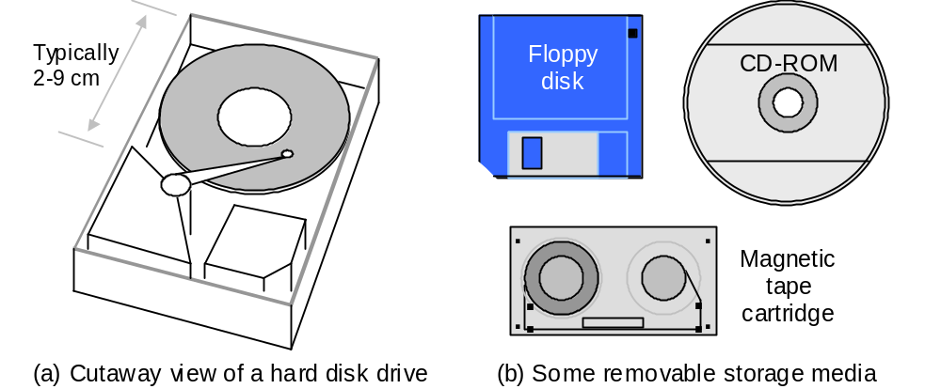
3.5 Input/Output and Communications
Figure 3.12 Magnetic and optical disk memory units.
Oct. 2014
Computer Architecture, Background and Motivation
Slide <number>

Slide 59
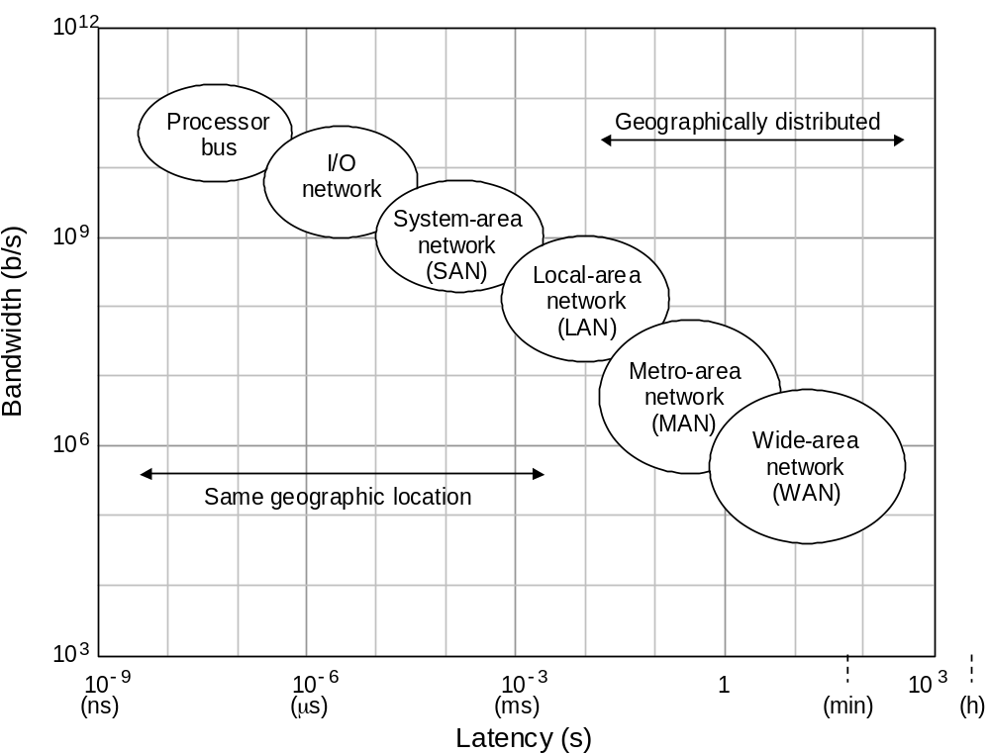
Communication Technologies
Figure 3.13 Latency and bandwidth characteristics of different classes of communication links.
Oct. 2014
Computer Architecture, Background and Motivation
Slide <number>

Slide 60
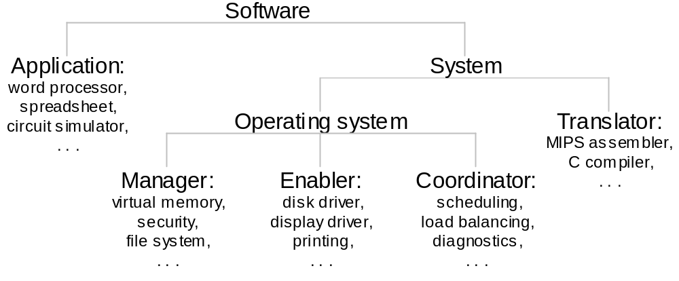
3.6 Software Systems and Applications
Figure 3.15 Categorization of software, with examples in each class.
Oct. 2014
Computer Architecture, Background and Motivation
Slide <number>

Slide 61
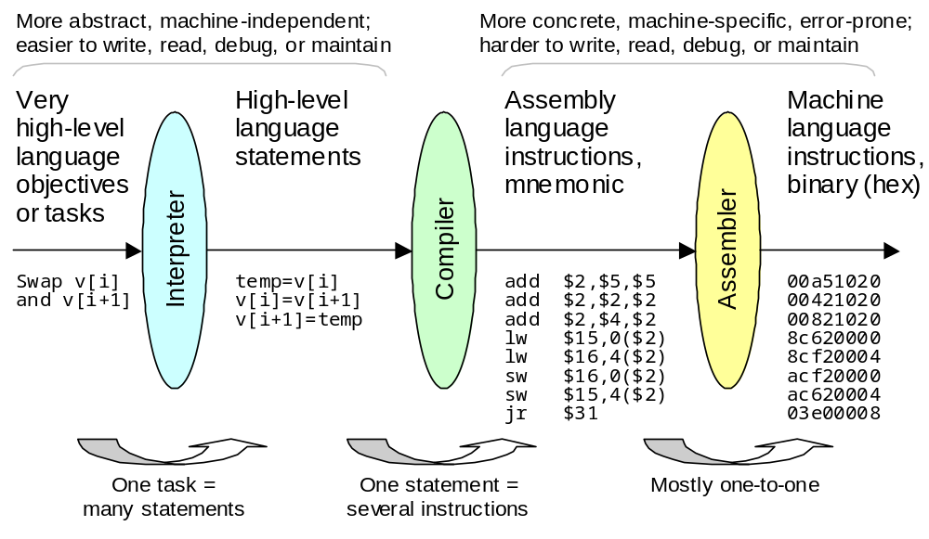
High- vs Low-Level Programming
Figure 3.14 Models and abstractions in programming.
Oct. 2014
Computer Architecture, Background and Motivation
Slide <number>

Slide 62
4 Computer Performance
Performance is key in design decisions; also cost and power
  It has been a driving force for innovation
  Isn’t quite the same as speed (higher clock rate)
Topics in This Chapter
4.1 Cost, Performance, and Cost/Performance
4.2 Defining Computer Performance
4.3 Performance Enhancement and Amdahl’s Law
4.4 Performance Measurement vs Modeling
4.5 Reporting Computer Performance
4.6 The Quest for Higher Performance
Oct. 2014
Computer Architecture, Background and Motivation
Slide <number>

Slide 63
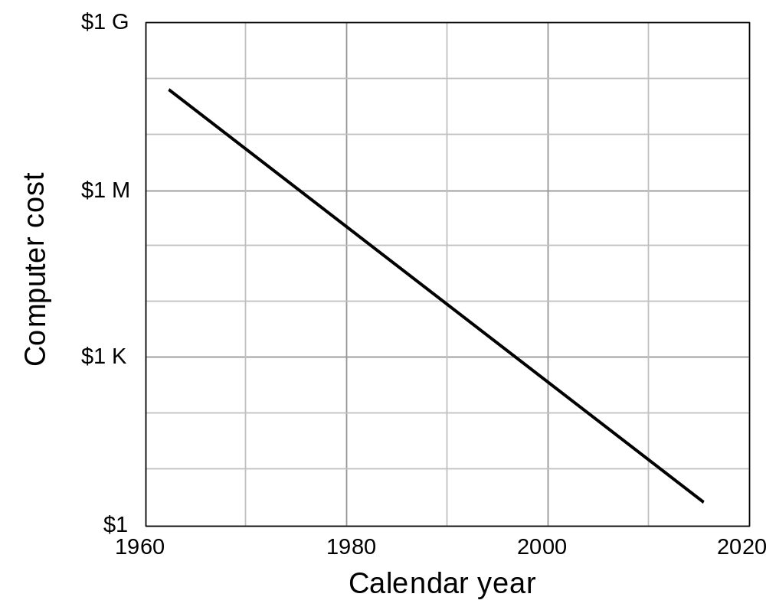
4.1 Cost, Performance, and Cost/Performance
Oct. 2014
Computer Architecture, Background and Motivation
Slide <number>

Slide 64

Cost/Performance
Figure 4.1 Performance improvement as a function of cost.
Oct. 2014
Computer Architecture, Background and Motivation
Slide <number>

Slide 65

4.2 Defining Computer Performance
Figure 4.2 Pipeline analogy shows that imbalance between processing power and I/O capabilities leads to a performance bottleneck.
Oct. 2014
Computer Architecture, Background and Motivation
Slide <number>

Slide 66






Six Passenger Aircraft to Be Compared
B 747
DC-8-50
Oct. 2014
Computer Architecture, Background and Motivation
Slide <number>

Slide 67
Performance of Aircraft: An Analogy
Table 4.1 Key characteristics of six passenger aircraft: all figures are approximate; some relate to a specific model/configuration of the aircraft or are averages of cited range of values.
Aircraft | Passengers | Range (km) | Speed (km/h) | Price ($M)
Airbus A310 | 250 | 8 300 | 895 | 120
Boeing 747 | 470 | 6 700 | 980 | 200
Boeing 767 | 250 | 12 300 | 885 | 120
Boeing 777 | 375 | 7 450 | 980 | 180
Concorde | 130 | 6 400 | 2 200 | 350
DC-8-50 | 145 | 14 000 | 875 | 80
Speed of sound ≈ 1220 km / h
Oct. 2014
Computer Architecture, Background and Motivation
Slide <number>

Slide 68
Different Views of Performance
Performance from the viewpoint of a passenger: Speed
Note, however, that flight time is but one part of total travel time.
Also, if the travel distance exceeds the range of a faster plane,
a slower plane may be better due to not needing a refueling stop
Performance from the viewpoint of an airline: Throughput
Measured in passenger-km per hour (relevant if ticket price were
proportional to distance traveled, which in reality it is not)
Airbus A310 250 × 895 = 0.224 M passenger-km/hr
Boeing 747 470 × 980 = 0.461 M passenger-km/hr
Boeing 767 250 × 885 = 0.221 M passenger-km/hr
Boeing 777 375 × 980 = 0.368 M passenger-km/hr
Concorde 130 × 2200 = 0.286 M passenger-km/hr
DC-8-50 145 × 875 = 0.127 M passenger-km/hr
Performance from the viewpoint of FAA: Safety
Oct. 2014
Computer Architecture, Background and Motivation
Slide <number>

Slide 69
Cost Effectiveness: Cost/Performance
Table 4.1 Key characteristics of six passenger aircraft: all figures are approximate; some relate to a specific model/configuration of the aircraft or are averages of cited range of values.
Larger
values
better
Smaller
values
better
Aircraft | Passen-gers | Range (km) | Speed (km/h) | Price ($M)
A310 | 250 | 8 300 | 895 | 120
B 747 | 470 | 6 700 | 980 | 200
B 767 | 250 | 12 300 | 885 | 120
B 777 | 375 | 7 450 | 980 | 180
Concorde | 130 | 6 400 | 2 200 | 350
DC-8-50 | 145 | 14 000 | 875 | 80
Throughput
(M P km/hr)
0.224
0.461
0.221
0.368
0.286
0.127
Cost / Performance
536
434
543
489
1224
630
Oct. 2014
Computer Architecture, Background and Motivation
Slide <number>

Slide 70
Concepts of Performance and Speedup
Performance = 1 / Execution time is simplified to
Performance = 1 / CPU execution time
(Performance of M₁) / (Performance of M₂) = Speedup of M₁ over M₂
= (Execution time of M₂) / (Execution time M₁)
Terminology: M₁ is x times as fast as M₂ (e.g., 1.5 times as fast)
M₁ is 100(x – 1)% faster than M₂ (e.g., 50% faster)
CPU time = Instructions × (Cycles per instruction) × (Secs per cycle)
= Instructions × CPI / (Clock rate)
Instruction count, CPI, and clock rate are not completely independent, so improving one by a given factor may not lead to overall execution time improvement by the same factor.
Oct. 2014
Computer Architecture, Background and Motivation
Slide <number>

Slide 71
Elaboration on the CPU Time Formula
CPU time = Instructions × (Cycles per instruction) × (Secs per cycle)
= Instructions × Average CPI / (Clock rate)
Instructions: Number of instructions executed, not number of
instructions in our program (dynamic count)
Average CPI: Is calculated based on the dynamic instruction mix
and knowledge of how many clock cycles are needed
to execute various instructions (or instruction classes)
Clock rate: 1 GHz = 10⁹ cycles / s (cycle time 10^{–9} s = 1 ns)
200 MHz = 200 × 10⁶ cycles / s (cycle time = 5 ns)
Clock period
Oct. 2014
Computer Architecture, Background and Motivation
Slide <number>

Slide 72
Dynamic Instruction Count
How many instructions are executed in this program fragment?
Each “for” consists of two instructions: increment index, check exit condition
12,422,450 Instructions
250 instructions
for i = 1, 100 do
20 instructions
for j = 1, 100 do
40 instructions
for k = 1, 100 do
10 instructions
endfor
endfor
endfor
2 + 20 + 124,200 instructions
100 iterations
12,422,200 instructions in all
2 + 40 + 1200 instructions
100 iterations
124,200 instructions in all
2 + 10 instructions
100 iterations
1200 instructions in all
for i = 1, n
while x > 0
Static count = 326
Oct. 2014
Computer Architecture, Background and Motivation
Slide <number>

Slide 73

Faster Clock ≠ Shorter Running Time
Suppose addition takes 1 ns
Clock period = 1 ns; 1 cycle
Clock period = ½ ns; 2 cycles
In this example, addition time
does not improve in going from
1 GHz to 2 GHz clock
Figure 4.3 Faster steps do not necessarily mean shorter travel time.
Oct. 2014
Computer Architecture, Background and Motivation
Slide <number>

Slide 74

4.3 Performance Enhancement: Amdahl’s Law
f = fraction
unaffected
p = speedup
of the rest
s =
≤ min(p, 1/f)
1
f + (1 – f)/p
Figure 4.4 Amdahl’s law: speedup achieved if a fraction f of a task is unaffected and the remaining 1 – f part runs p times as fast.
Oct. 2014
Computer Architecture, Background and Motivation
Slide <number>
Notes:
This is the original Excel chart before cutting and pasting it to a Word diagram to get rid of excessive margins

Slide 75
Amdahl’s Law Used in Design
Example 4.1
A processor spends 30% of its time on flp addition, 25% on flp mult,
and 10% on flp division. Evaluate the following enhancements, each
costing the same to implement:
Redesign of the flp adder to make it twice as fast.
Redesign of the flp multiplier to make it three times as fast.
Redesign the flp divider to make it 10 times as fast.
Solution
Adder redesign speedup = 1 / [0.7 + 0.3 / 2] = 1.18
Multiplier redesign speedup = 1 / [0.75 + 0.25 / 3] = 1.20
Divider redesign speedup = 1 / [0.9 + 0.1 / 10] = 1.10
What if both the adder and the multiplier are redesigned?
Oct. 2014
Computer Architecture, Background and Motivation
Slide <number>

Slide 76
Amdahl’s Law Used in Management
Example 4.2
Members of a university research group frequently visit the library.
Each library trip takes 20 minutes. The group decides to subscribe
to a handful of publications that account for 90% of the library trips;
access time to these publications is reduced to 2 minutes.
What is the average speedup in access to publications?
If the group has 20 members, each making two weekly trips to the library, what is the justifiable expense for the subscriptions? Assume 50 working weeks/yr and $25/h for a researcher’s time.
Solution
Speedup in publication access time = 1 / [0.1 + 0.9 / 10] = 5.26
Time saved = 20 × 2 × 50 × 0.9 (20 – 2) = 32,400 min = 540 h
Cost recovery = 540 × $25 = $13,500 = Max justifiable expense
Oct. 2014
Computer Architecture, Background and Motivation
Slide <number>

Slide 77

4.4 Performance Measurement vs Modeling
Figure 4.5 Running times of six programs on three machines.
Oct. 2014
Computer Architecture, Background and Motivation
Slide <number>

Slide 78
Generalized Amdahl’s Law
Original running time of a program = 1 = f₁ + f₂ + . . . + f_{k}
New running time after the fraction f_{i} is speeded up by a factor p_{i}
f₁ f₂ f_{k}
+ + . . . +
p₁ p₂ p_{k}
Speedup formula
1
S =
f₁ f₂ f_{k}
+ + . . . +
p₁ p₂ p_{k}
If a particular fraction
is slowed down rather than speeded up,
use s_{j} f_{j} instead of f_{j} / p_{j} , where s_{j} > 1 is the slowdown factor
Oct. 2014
Computer Architecture, Background and Motivation
Slide <number>

Slide 79
Performance Benchmarks
Example 4.3
You are an engineer at Outtel, a start-up aspiring to compete with Intel
via its new processor design that outperforms the latest Intel processor
by a factor of 2.5 on floating-point instructions. This level of performance
was achieved by design compromises that led to a 20% increase in the
execution time of all other instructions. You are in charge of choosing
benchmarks that would showcase Outtel’s performance edge.
What is the minimum required fraction f of time spent on floating-point instructions in a program on the Intel processor to show a speedup of 2 or better for Outtel?
Solution
We use a generalized form of Amdahl’s formula in which a fraction f is speeded up by a given factor (2.5) and the rest is slowed down by another factor (1.2): 1 / [1.2(1 – f) + f / 2.5] ≥ 2 ⇒ f ≥ 0.875
Oct. 2014
Computer Architecture, Background and Motivation
Slide <number>

Slide 80
Performance Estimation
Average CPI = ∑_{All instruction classes} (Class-i fraction) × (Class-i CPI)
Machine cycle time = 1 / Clock rate
CPU execution time = Instructions × (Average CPI) / (Clock rate)
Table 4.3 Usage frequency, in percentage, for various instruction classes in four representative applications.
Application → Instr’n class ↓ | Data compression | C language compiler | Reactor simulation | Atomic motion modeling
A: Load/Store | 25 | 37 | 32 | 37
B: Integer | 32 | 28 | 17 | 5
C: Shift/Logic | 16 | 13 | 2 | 1
D: Float | 0 | 0 | 34 | 42
E: Branch | 19 | 13 | 9 | 10
F: All others | 8 | 9 | 6 | 4
Oct. 2014
Computer Architecture, Background and Motivation
Slide <number>

Slide 81
CPI and IPS Calculations
Example 4.4 (2 of 5 parts)
Consider two implementations M₁ (600 MHz) and M₂ (500 MHz) of
an instruction set containing three classes of instructions:
Class CPI for M₁ CPI for M₂ Comments
F 5.0 4.0 Floating-point
I 2.0 3.8 Integer arithmetic
N 2.4 2.0 Nonarithmetic
What are the peak performances of M₁ and M₂ in MIPS?
If 50% of instructions executed are class-N, with the rest divided equally among F and I, which machine is faster? By what factor?
Solution
Peak MIPS for M₁ = 600 / 2.0 = 300; for M₂ = 500 / 2.0 = 250
b. Average CPI for M₁ = 5.0 / 4 + 2.0 / 4 + 2.4 / 2 = 2.95;
for M₂ = 4.0 / 4 + 3.8 / 4 + 2.0 / 2 = 2.95 → M₁ is faster; factor 1.2
Oct. 2014
Computer Architecture, Background and Motivation
Slide <number>

Slide 82
MIPS Rating Can Be Misleading
Example 4.5
Two compilers produce machine code for a program on a machine
with two classes of instructions. Here are the number of instructions:
Class CPI Compiler 1 Compiler 2
A 1 600M 400M
B 2 400M 400M
What are run times of the two programs with a 1 GHz clock?
Which compiler produces faster code and by what factor?
Which compiler’s output runs at a higher MIPS rate?
Solution
Running time 1 (2) = (600M × 1 + 400M × 2) / 10⁹ = 1.4 s (1.2 s)
b. Compiler 2’s output runs 1.4 / 1.2 = 1.17 times as fast
c. MIPS rating 1, CPI = 1.4 (2, CPI = 1.5) = 1000 / 1.4 = 714 (667)
Oct. 2014
Computer Architecture, Background and Motivation
Slide <number>

Slide 83
4.5 Reporting Computer Performance
Table 4.4 Measured or estimated execution times for three programs.
 | Time on machine X | Time on machine Y | Speedup of Y over X
Program A | 20 | 200 | 0.1
Program B | 1000 | 100 | 10.0
Program C | 1500 | 150 | 10.0
All 3 prog’s | 2520 | 450 | 5.6
Analogy: If a car is driven to a city 100 km away at 100 km/hr and returns at 50 km/hr, the average speed is not (100 + 50) / 2 but is obtained from the fact that it travels 200 km in 3 hours.
Oct. 2014
Computer Architecture, Background and Motivation
Slide <number>

Slide 84
Comparing the Overall Performance
Table 4.4 Measured or estimated execution times for three programs.
 | Time on machine X | Time on machine Y | Speedup of Y over X
Program A | 20 | 200 | 0.1
Program B | 1000 | 100 | 10.0
Program C | 1500 | 150 | 10.0
Speedup of X over Y
10
0.1
0.1
Arithmetic mean
6.7
3.4
Geometric mean
2.15
0.46
Geometric mean does not yield a measure of overall speedup, but provides an indicator that at least moves in the right direction
Oct. 2014
Computer Architecture, Background and Motivation
Slide <number>

Slide 85
Effect of Instruction Mix on Performance
Example 4.6 (1 of 3 parts)
Consider two applications DC and RS and two machines M₁ and M₂:
Class Data Comp. Reactor Sim. M₁’s CPI M₂’s CPI
A: Ld/Str 25% 32% 4.0 3.8
B: Integer 32% 17% 1.5 2.5
C: Sh/Logic 16% 2% 1.2 1.2
D: Float 0% 34% 6.0 2.6
E: Branch 19% 9% 2.5 2.2
F: Other 8% 6% 2.0 2.3
Find the effective CPI for the two applications on both machines.
Solution
CPI of DC on M₁: 0.25 × 4.0 + 0.32 × 1.5 + 0.16 × 1.2 + 0 × 6.0 +
0.19 × 2.5 + 0.08 × 2.0 = 2.31
DC on M₂: 2.54 RS on M₁: 3.94 RS on M₂: 2.89
Oct. 2014
Computer Architecture, Background and Motivation
Slide <number>

Slide 86
4.6 The Quest for Higher Performance
State of available computing power ca. the early 2000s:
Gigaflops on the desktop
Teraflops in the supercomputer center
Petaflops on the drawing board
Note on terminology (see Table 3.1)
Prefixes for large units:
Kilo = 10³, Mega = 10⁶, Giga = 10⁹, Tera = 10¹², Peta = 10¹⁵
For memory:
K = 2¹⁰ = 1024, M = 2²⁰, G = 2³⁰, T = 2⁴⁰, P = 2⁵⁰
Prefixes for small units:
micro = 10⁻⁶, nano = 10⁻⁹, pico = 10⁻¹², femto = 10⁻¹⁵
Oct. 2014
Computer Architecture, Background and Motivation
Slide <number>

Slide 87

Performance Trends and Obsolescence
“Can I call you back? We just bought a new computer and we’re trying to set it up before it’s obsolete.”
Figure 3.10 Trends in processor performance and DRAM memory chip capacity (Moore’s law).
Oct. 2014
Computer Architecture, Background and Motivation
Slide <number>

Slide 88

Super-computers
Figure 4.7 Exponential growth of supercomputer performance.
Oct. 2014
Computer Architecture, Background and Motivation
Slide <number>

Slide 89

The Most Powerful Computers
Figure 4.8 Milestones in the DOE’s Accelerated Strategic Computing Initiative (ASCI) program with extrapolation up to the PFLOPS level.
Oct. 2014
Computer Architecture, Background and Motivation
Slide <number>

Slide 90

Performance is Important, But It Isn’t Everything
Figure 25.1 Trend in computational performance per watt of power used
in general-purpose processors and DSPs.
Oct. 2014
Computer Architecture, Background and Motivation
Slide <number>

Slide 91

Roadmap for the Rest of the Book
Fasten your seatbelts as we begin our ride!
Ch. 5-8: A simple ISA, variations in ISA
Ch. 9-12: ALU design
Ch. 13-14: Data path and control unit design
Ch. 15-16: Pipelining and its limits
Ch. 17-20: Memory (main, mass, cache, virtual)
Ch. 21-24: I/O, buses, interrupts, interfacing
Ch. 25-28: Vector and parallel processing
Oct. 2014
Computer Architecture, Background and Motivation
Slide <number>

